Slide 1
4D birds
Nicolas Hsu

Slide 2
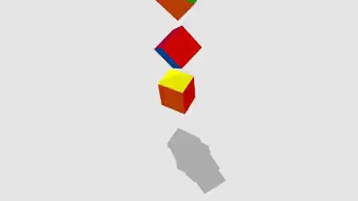
Inspiration – 4D Toys (Marc Ten Bosch)
https://4dtoys.com/

Slide 3
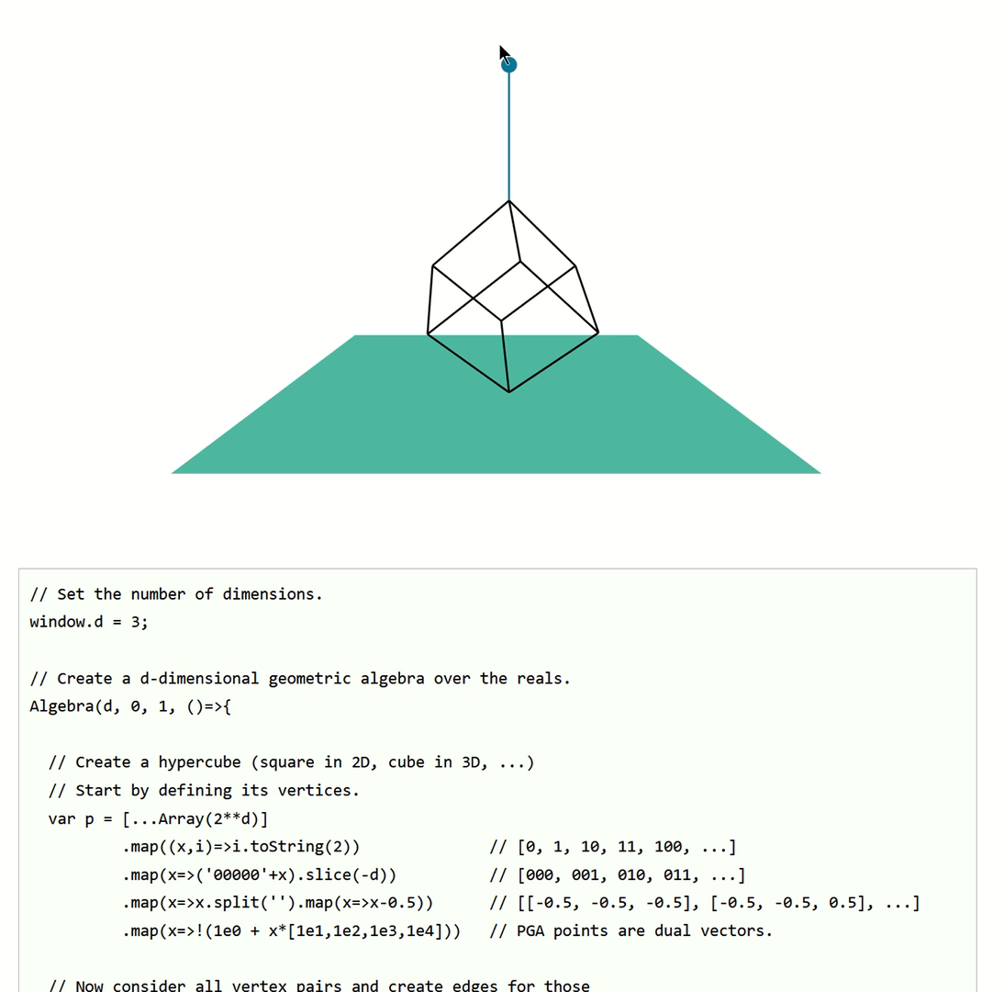
Inspiration – May The Forque Be With You (Leo Dorst & Steven De Keninck)
“set the number of dimensions”
https://enki.ws/ganja.js/examples/pga_dyn.html

Slide 4
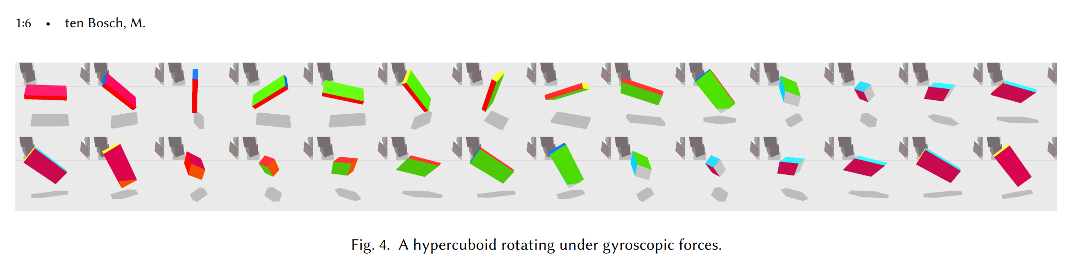
4D Dzhanibekov effect
https://marctenbosch.com/ndphysics/NDrigidbody.pdf

Slide 5
Math

Slide 6
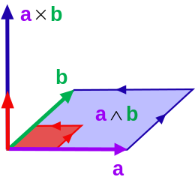
No cross products in 4D

Slide 7
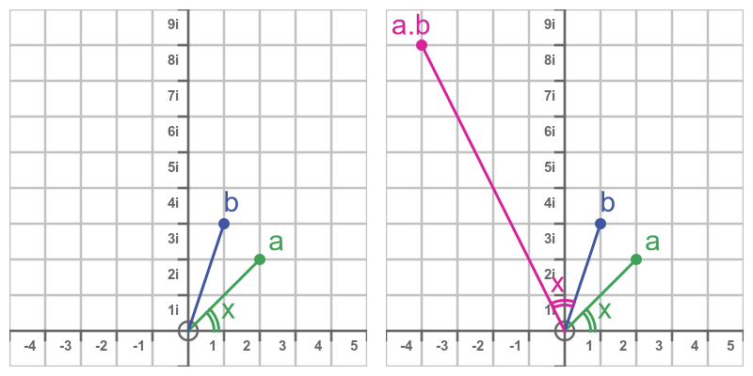
Complex Numbers – 2D rotations
i^2=-1
https://graphicmaths.com/pure/complex-numbers/why-multiplication-rotates/

Slide 8
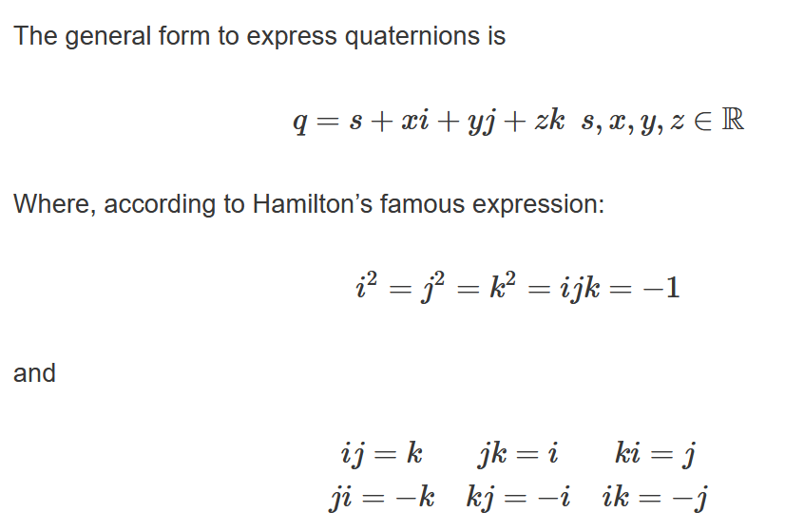
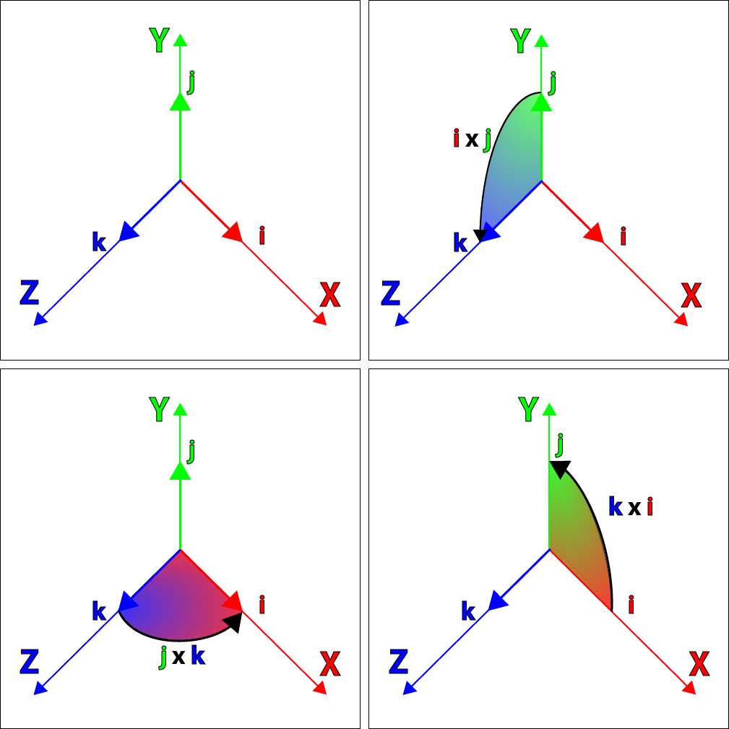
Quaternions – 3D rotations
https://www.3dgep.com/understanding-quaternions/

Slide 9
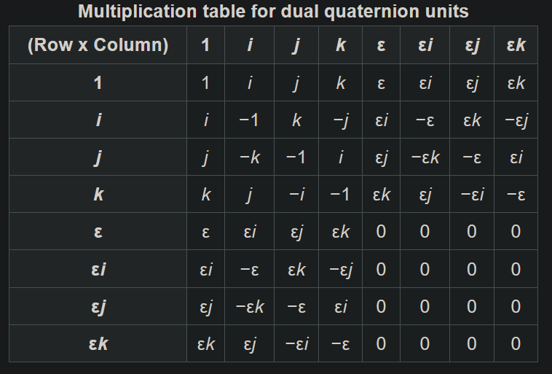
Dual Quaternions – 3D rigid motion
https://en.wikipedia.org/wiki/Dual_quaternion

Slide 10
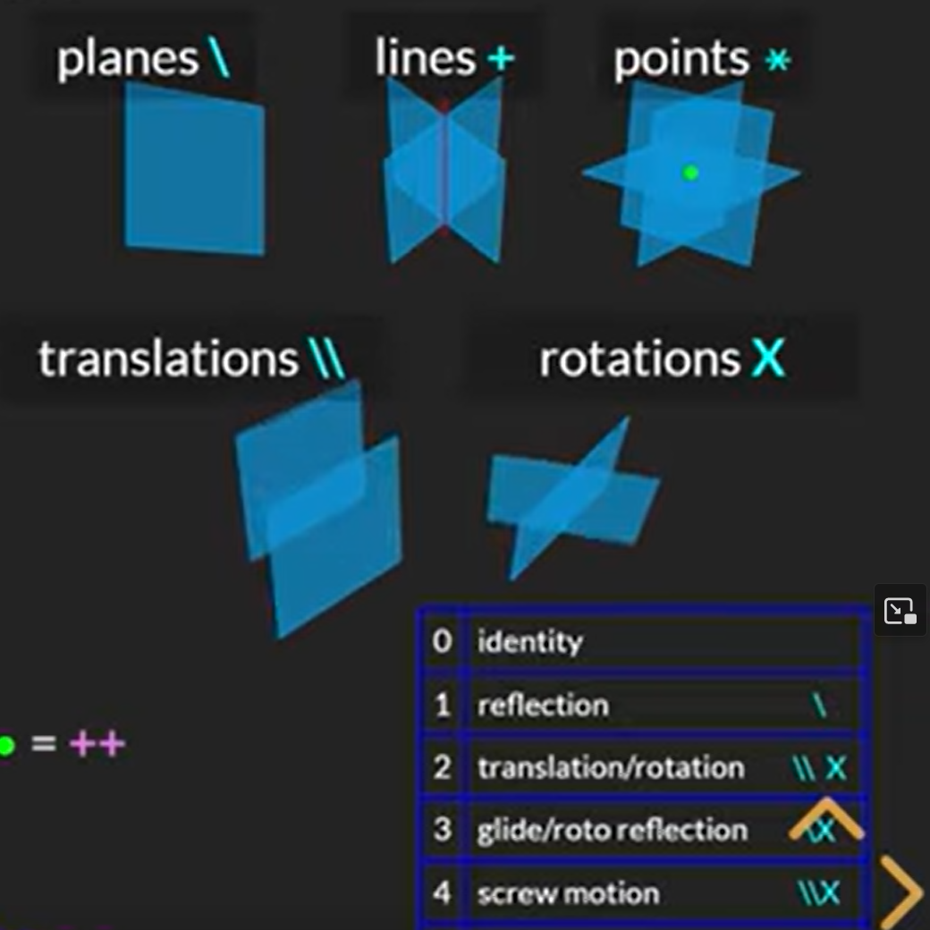
Planes ✈️ / reflection is all you need
eigenvectors
translations/rotations together
https://youtu.be/pq9YfdPHhIo

Slide 11
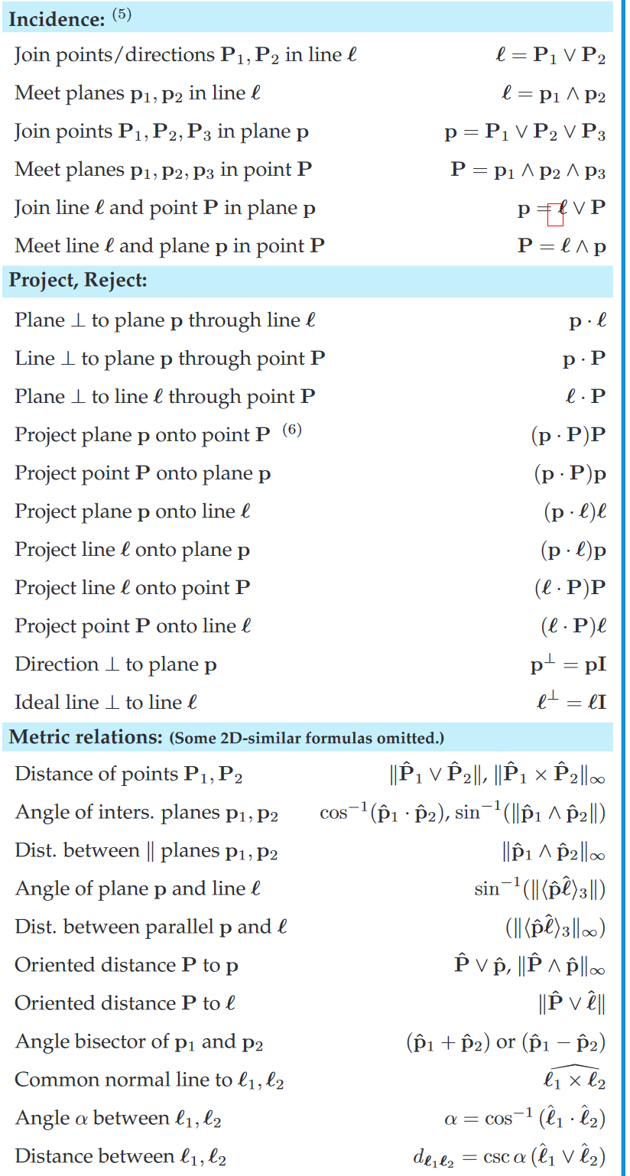
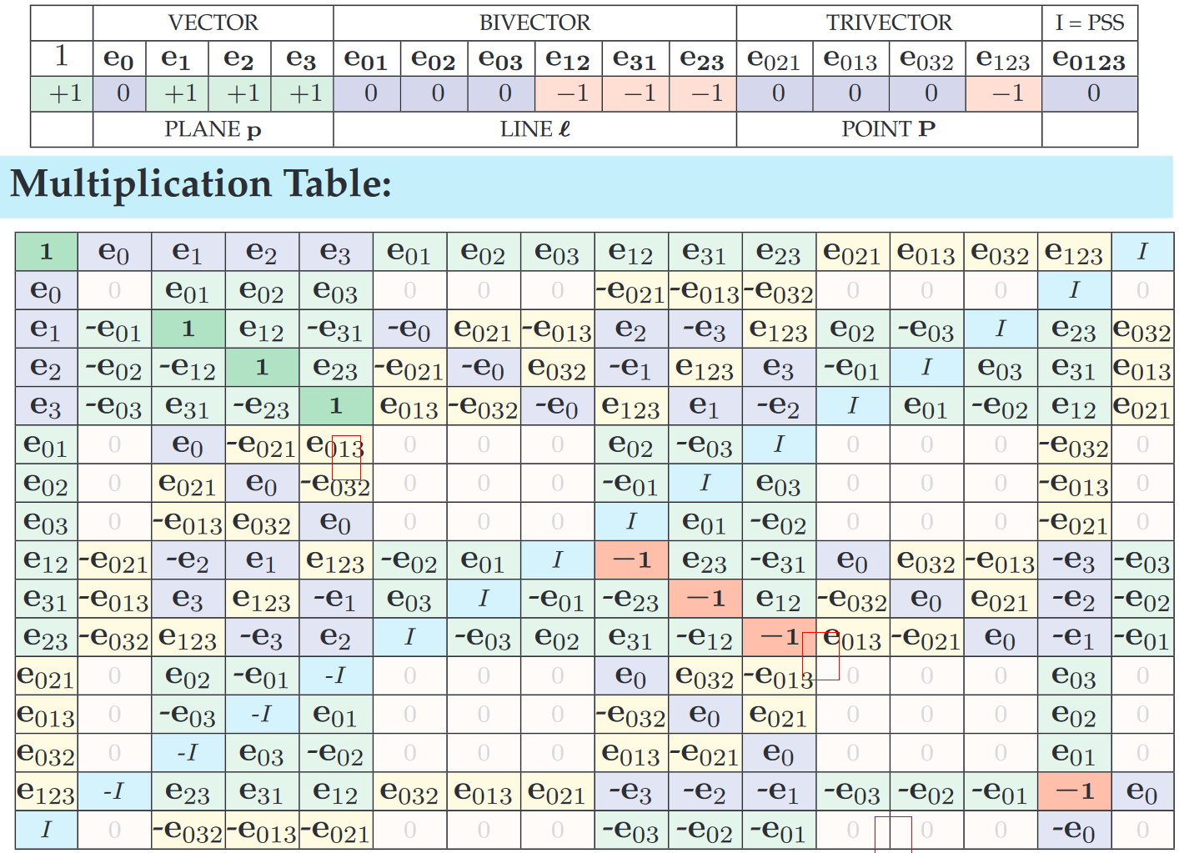
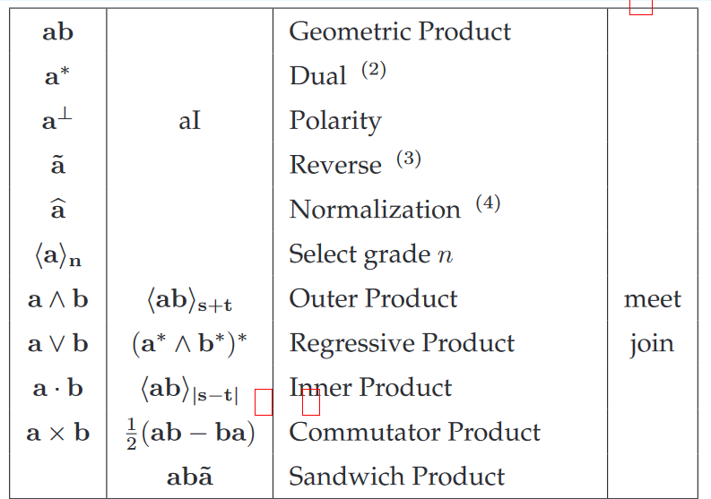
“3D Plane-based Geometric Algebra” – 3D lots of stuff
extends to n-D
https://bivector.net/3DPGA.pdf

Slide 12
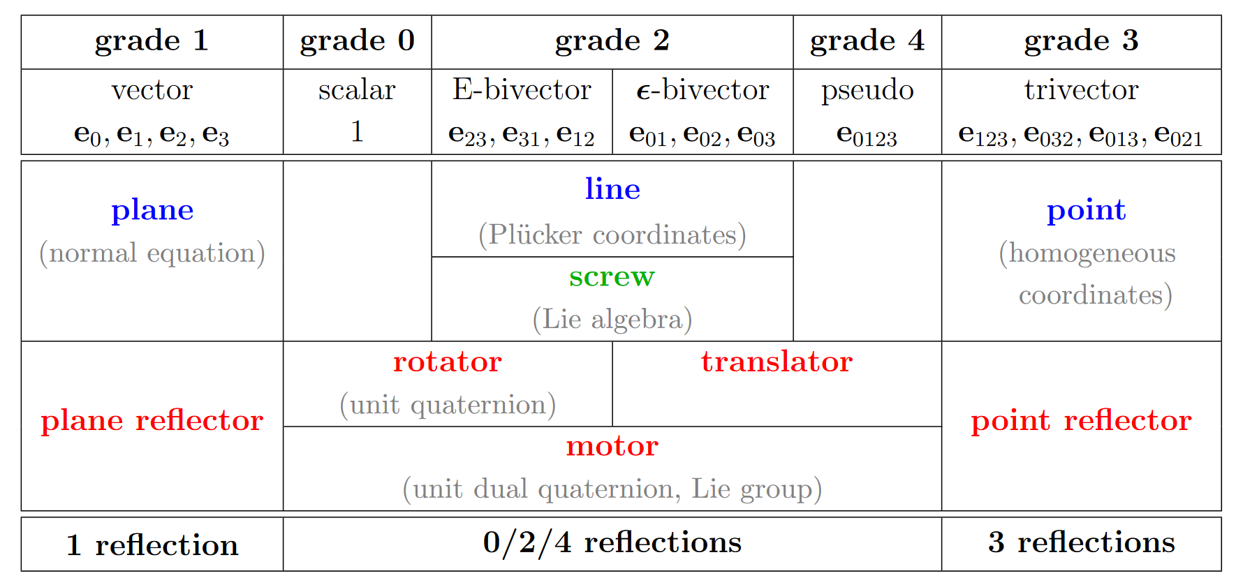
note – PGA is not really new
https://bivector.net/PGAdyn.pdf

Slide 13
3D Rigid Bodies in PGA

Slide 14
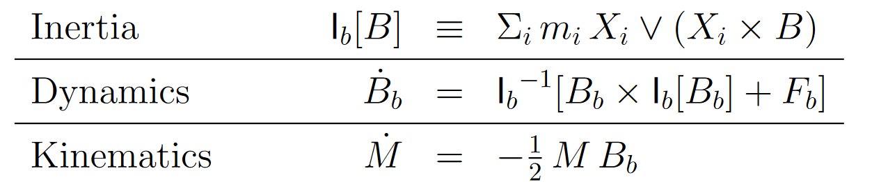
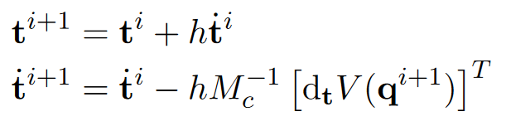
Equations of motion
M = “motion” (position + orientation) B = “rate” (B for bivector?)
top: https://bivector.net/PGAdyn.pdf, bottom right: course notes

Slide 15
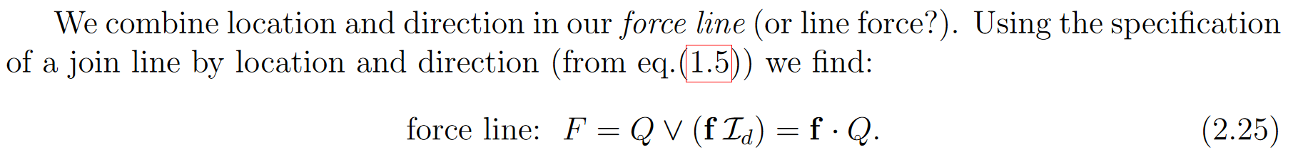
“Forques” (wrenches)
https://bivector.net/PGAdyn.pdf

Slide 16
3D -> 4D
mostly engineering

Slide 17
4D renderer
main language: Rust
shader language: WGSL

Slide 18

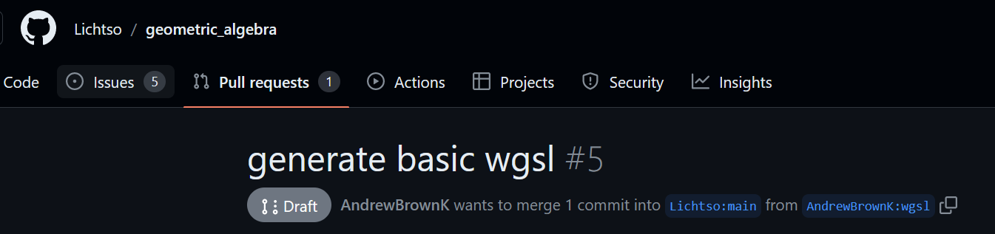
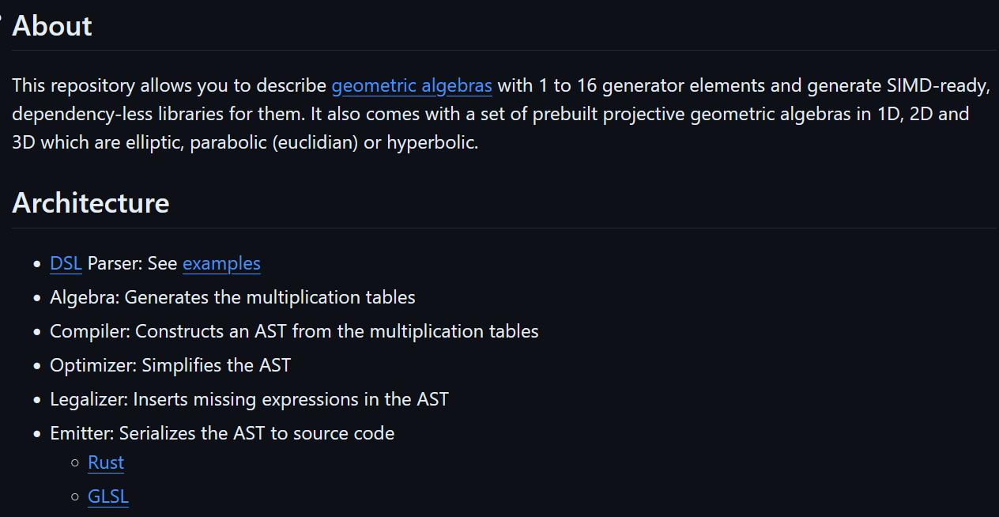
PGA library?
https://github.com/Lichtso/geometric_algebra

Slide 19
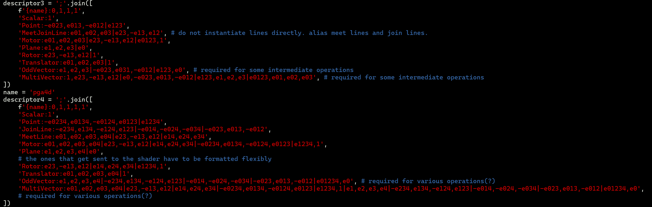
Specify the elements

Slide 20
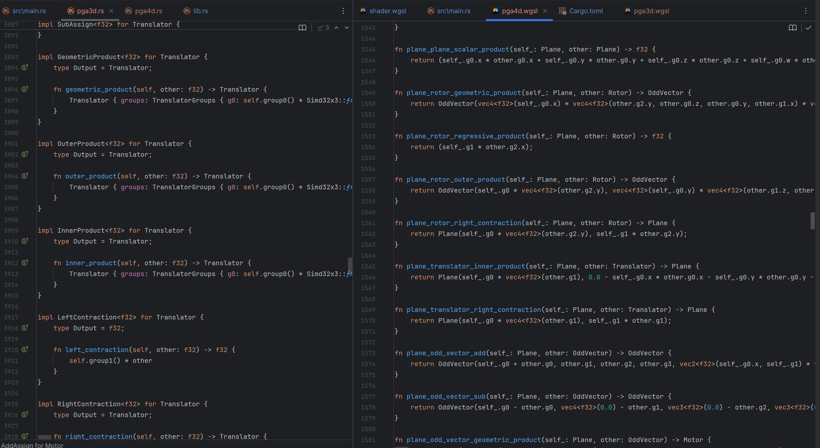
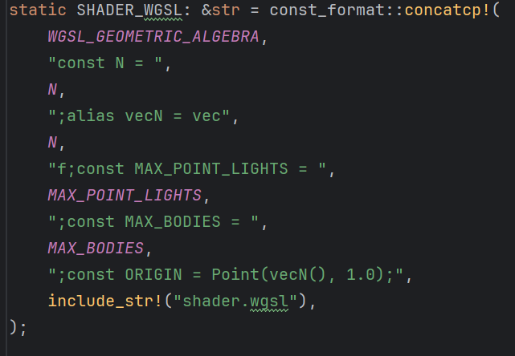
Generate and import the library

Slide 21
Takeaway
be careful with third-party code
choose tools wisely

Slide 22
Remaining/future work
in 4D, inertia map returns zero / inverse inertia map returns NaN
T-body effect
object-object collision (separating axis theorem)
impulse-based collisions
more objects, better controls

Slide 23
thanks

